Slide 1

Mason Fidino, Ph.D.
Some insights I’ve gleaned from working with occupancy surveys and modeling over the last decade
ψ
ρ

Slide 2

On designing occupancy surveys…

Slide 3
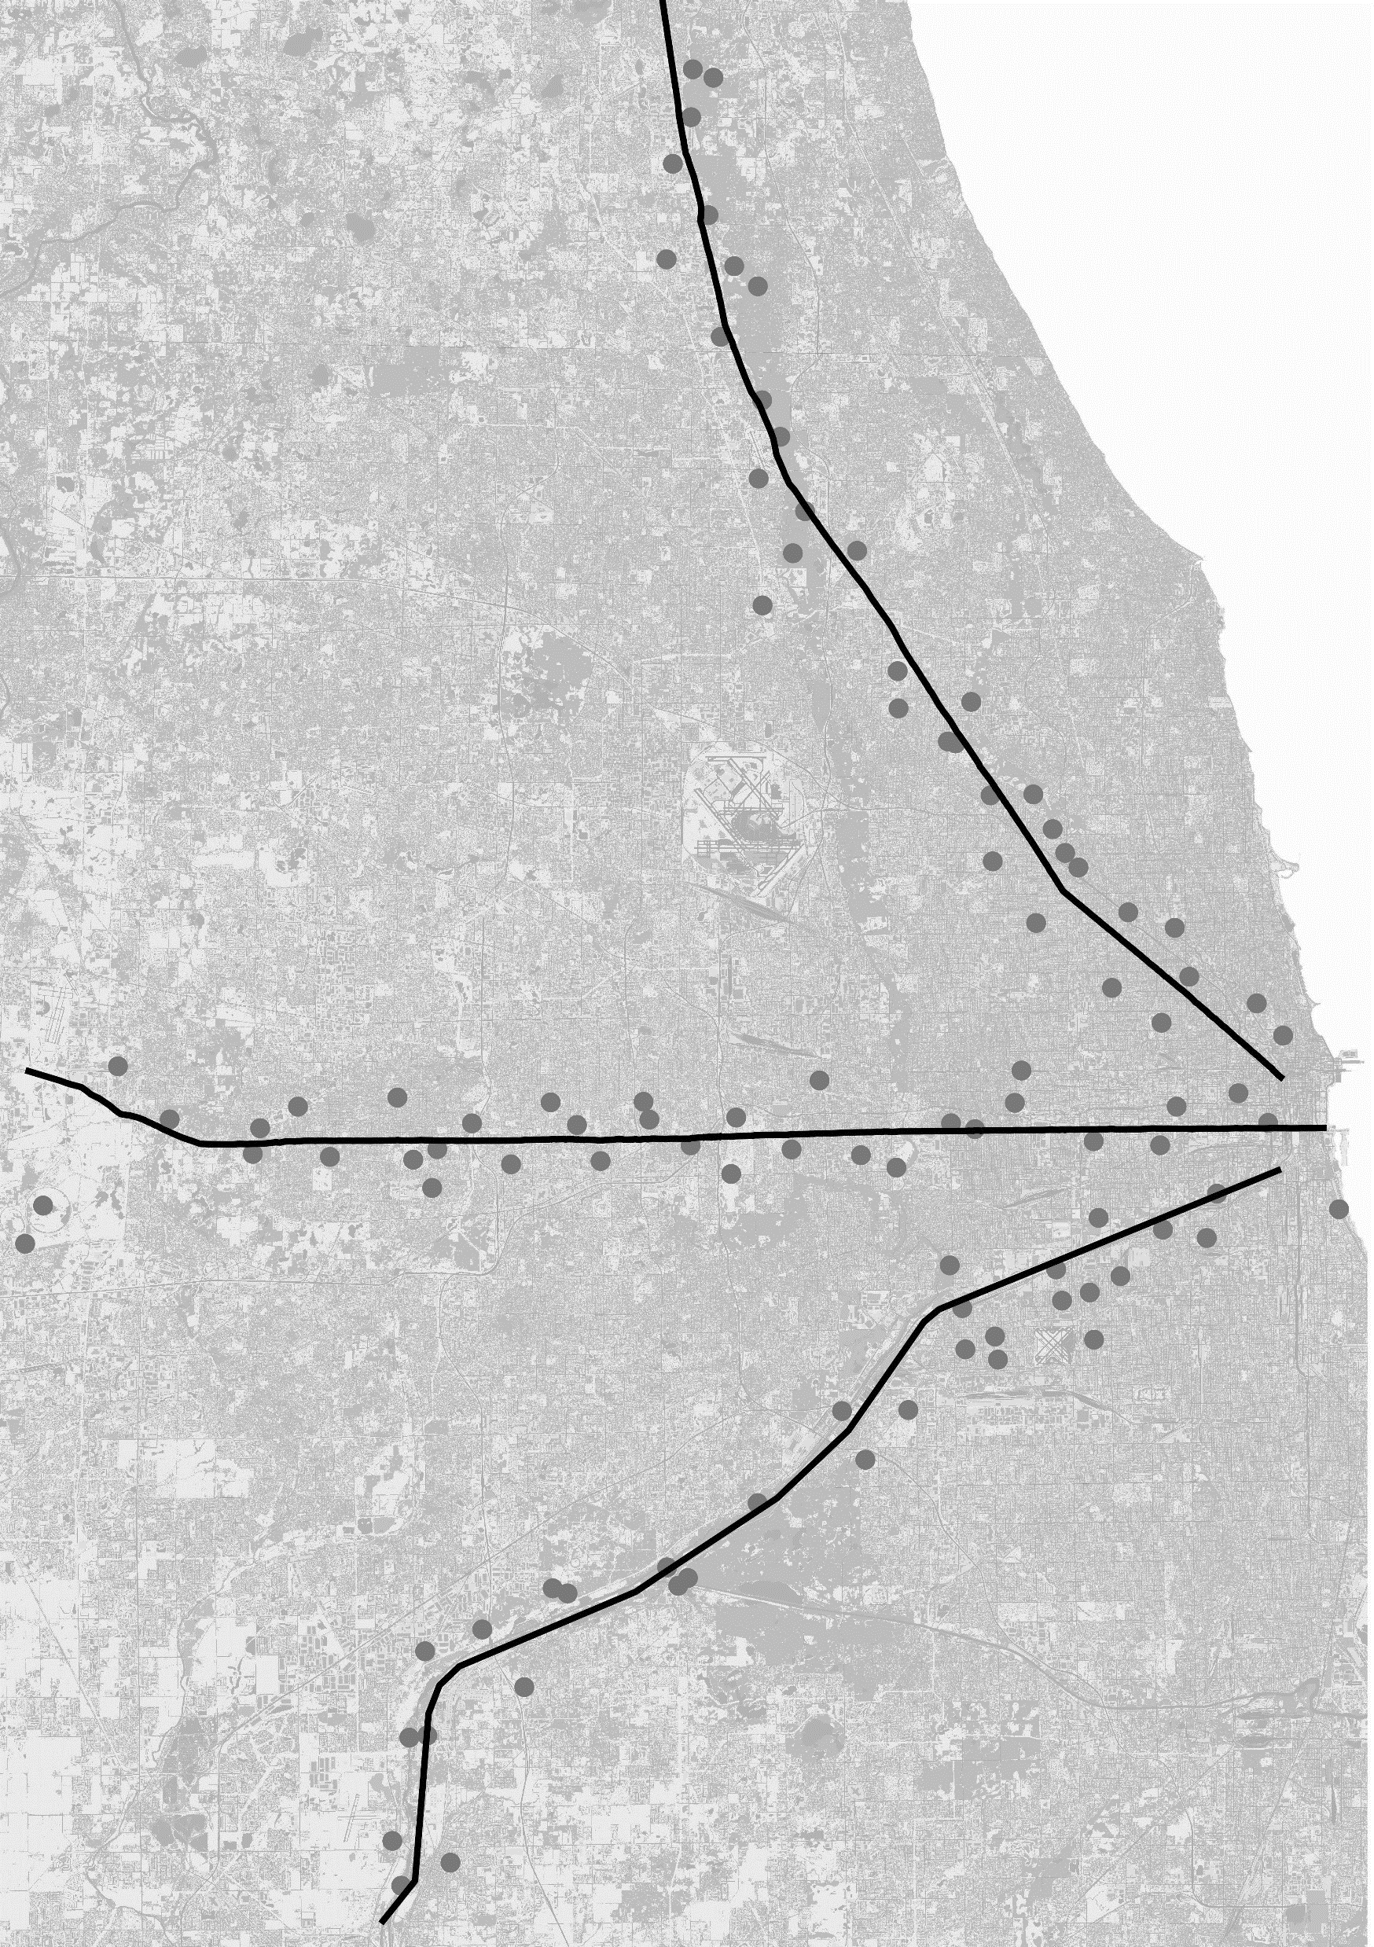
First off. I got lucky.
Binary data is information poor
You need a decent sample size
How big a sample depends on
Your research question
If your species is too rare or too common
What flavor of model you want to use
See Kays et al. (2020)

Slide 4
Tricks to increase sample size when working with a fixed number of cameras

Slide 5
Tricks to increase sample size when working with a fixed number of cameras
Sample through time
Primary sampling period 1 (e.g., a UWIN season)
Primary sampling period 2 (e.g., a UWIN season)
Primary sampling period 3 (e.g., a UWIN season)
Secondary sampling periods (e.g., days or weeks of camera trapping)
Secondary sampling periods (e.g., days or weeks of camera trapping)
Secondary sampling periods (e.g., days or weeks of camera trapping)

Slide 6
Tricks to increase sample size when working with a fixed number of cameras
Extend primary sampling period & move cameras
Sample these locations during first half of the survey

Slide 7
Tricks to increase sample size when working with a fixed number of cameras
Extend primary sampling period & move cameras
Shift some or all of them to other locations for second half of survey

Slide 8
Tricks to increase sample size when working with a fixed number of cameras
Extend primary sampling period & move cameras
All unique locations across primary sampling period

Slide 9
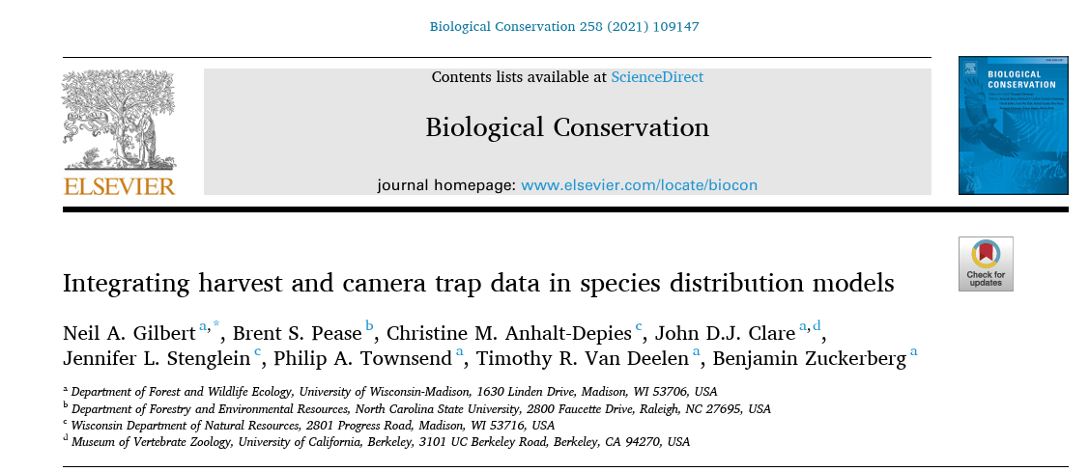
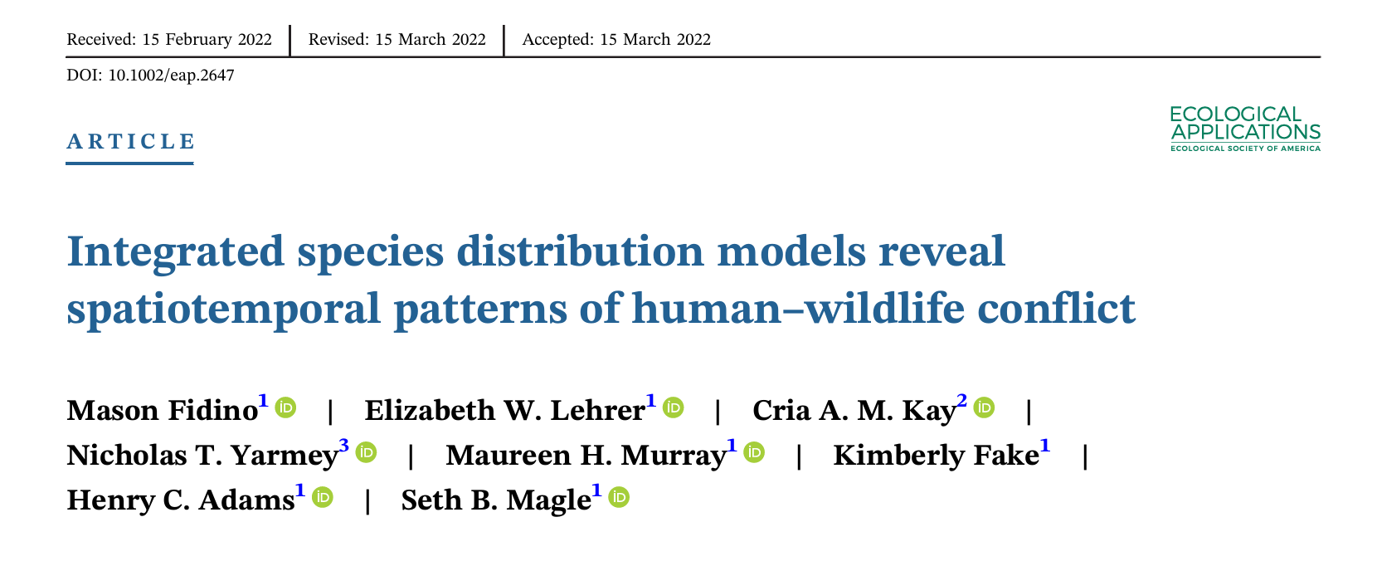
Tricks to increase sample size when working with a fixed number of cameras
Consider other data sources to increase sample size and use integrated models (most complex suggestion)

Slide 10
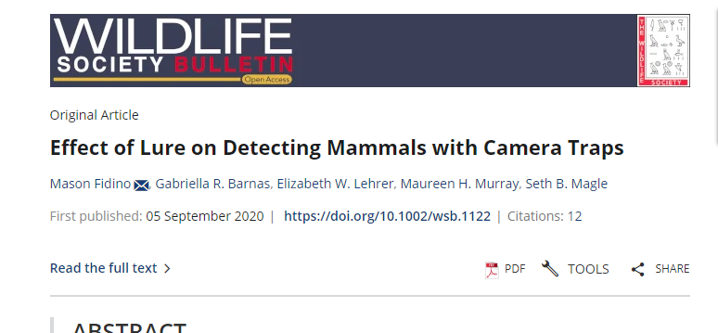
But what if you are planning a study?
Simulation studies / power analyses can help considerably
Used 20 sites, 2 cameras per site
Common species
Decided to use a 5% increase in detection as effect size to determine number of sites, assuming species occupied each location

Slide 11
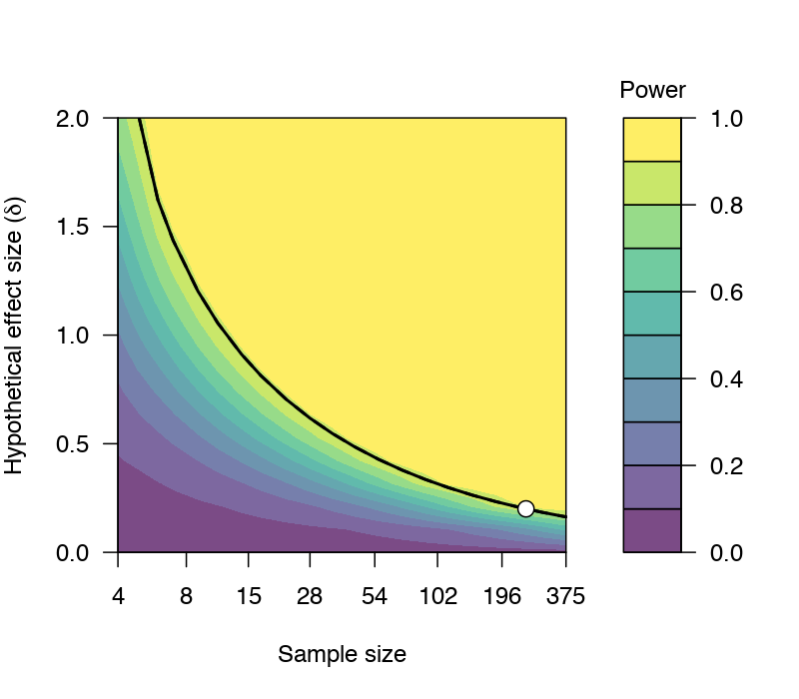
To do a power analysis well…
Know the goals of your study (e.g., your hypotheses)
Convert your goals into statistical models
Parameterize statistical models (e.g., expert opinion, pilot data,etc.).
Conduct power analysis with varying number of sites, effect sizes, etc.

Slide 12
We should think about our statistical models before we go out and collect data?

Slide 13
Incorrect things that often get brought up during peer review…

Slide 14
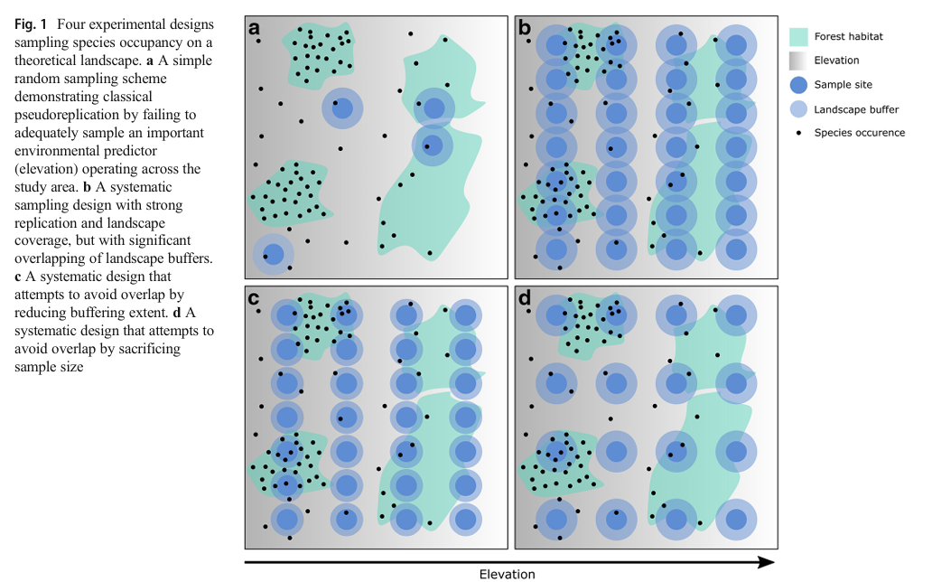
Overlapping buffers is not pseudo-replication, nor does it increase spatial autocorrelation (Zuckerberg et al. 2020)

Slide 15
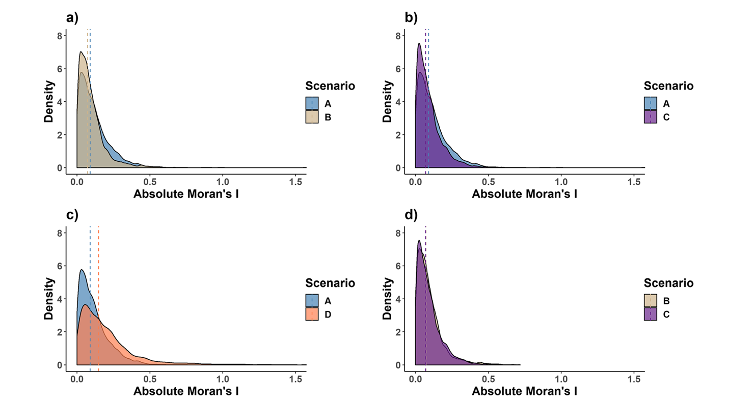
There is no difference in spatial autocorrelation when using overlapping or reduced buffers (Zuckerberg et al. 2020)
Random
Overlap
Reduced buffers
Reduced sample size

Slide 16
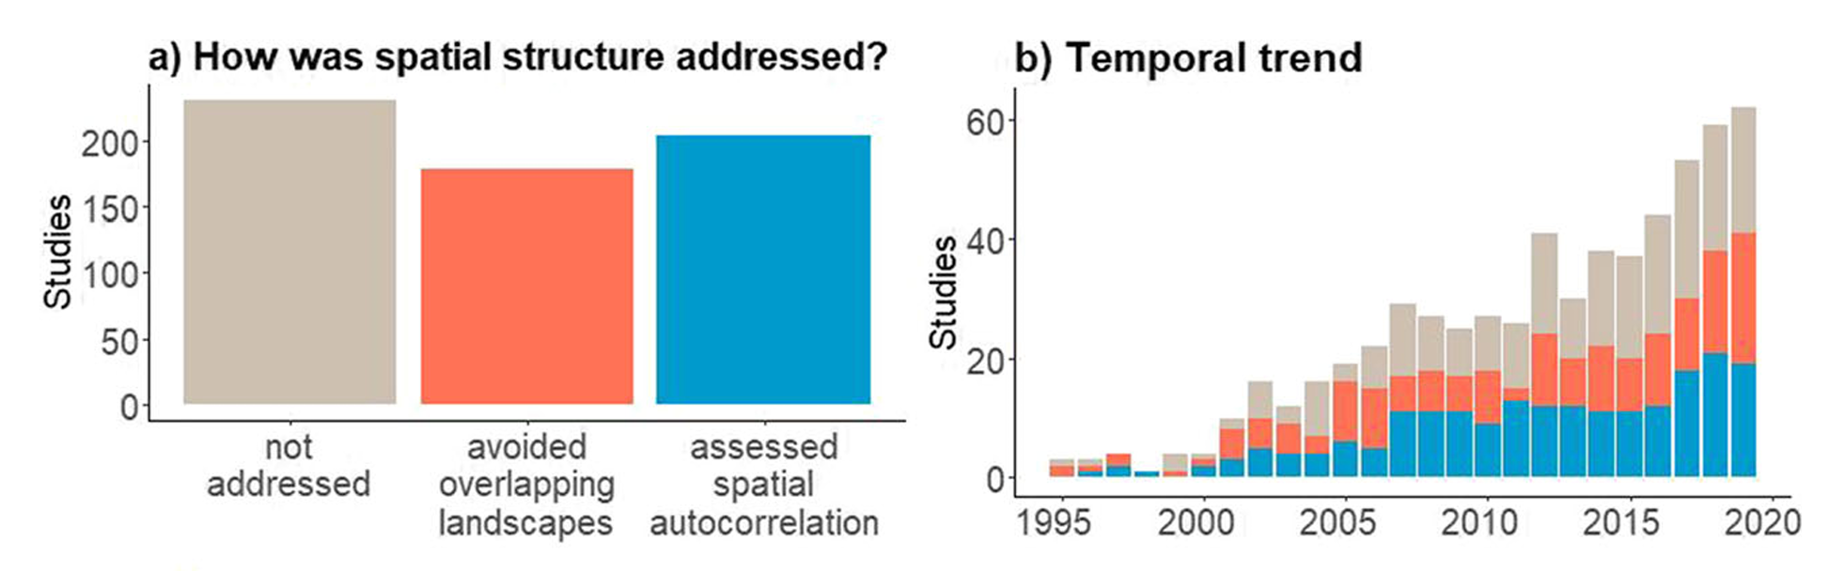
Overlapping buffers is not pseudo-replication, nor does it increase spatial autocorrelation (Zuckerberg et al. 2020)

Slide 17

The optimal spatial scale species respond to urban intensity is quite broad (or unknown)

Slide 18
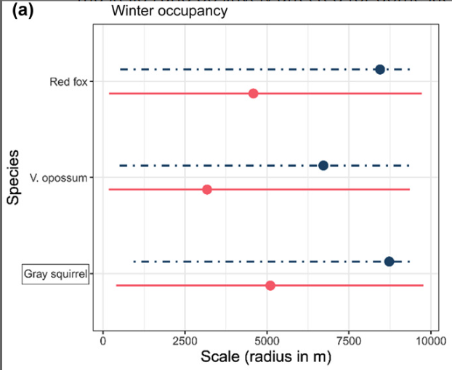
Moll et al. show that the optimal scale for some North American mammals is somewhere between 0 and 10 km based on 95% CI.
Notes:
91 blue whales
50,000 bananas
10 million ants
500,000 iphones

Slide 19
So what scale should you use?
It may not matter, as variables are often highly correlated across scales (500 m vs 1000 m vs 1500 m).
For a study on one species, see if you can find their average home range size.
For a study on multiple species, what is the average among all their home ranges?
I personally default to 1000 m (mostly due to the first point above).

Slide 20
Things you will likely need some data cleaning skills for…

Slide 21
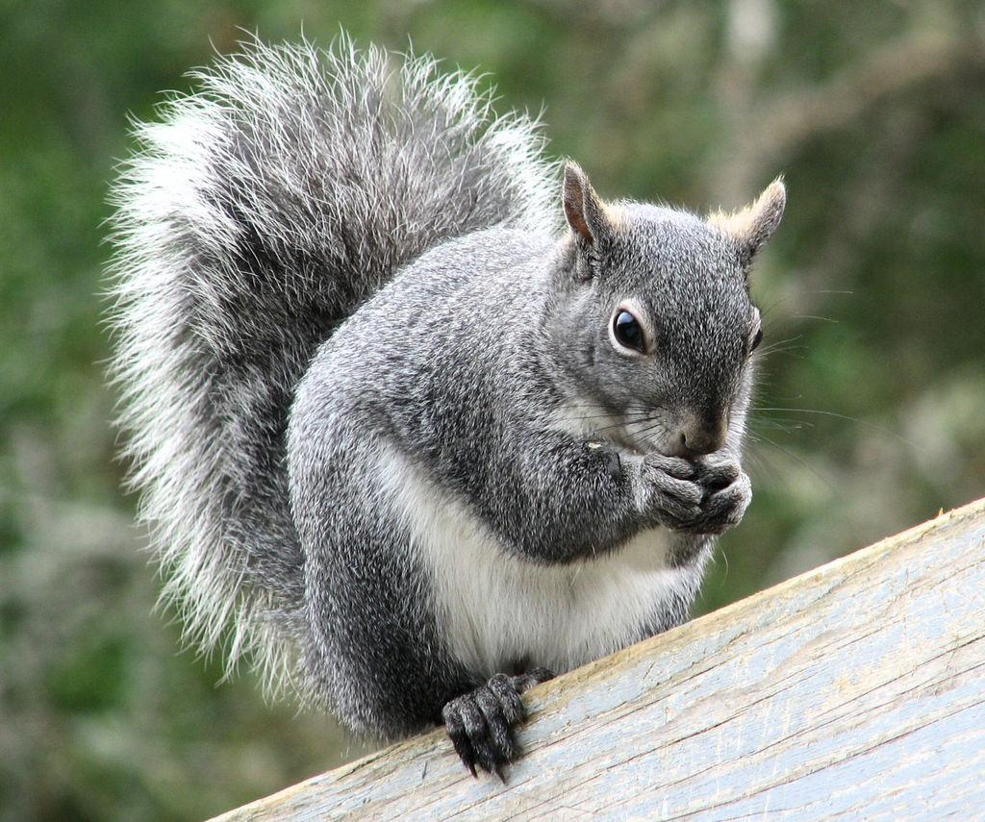
Common pitfalls I’ve encountered
Giving people open text fields to add species.
“gray squirrel”
“grey squirrel”
“gray squirrel “
“gray squirrel”
“gray squirel“
“grey squirel”
“ gray squirrel”

Slide 22
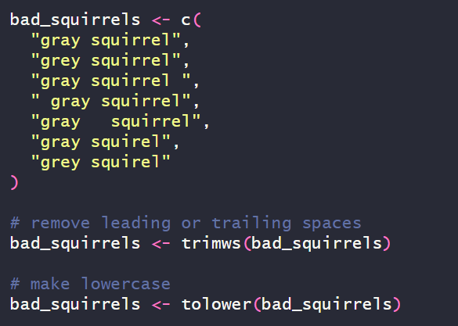
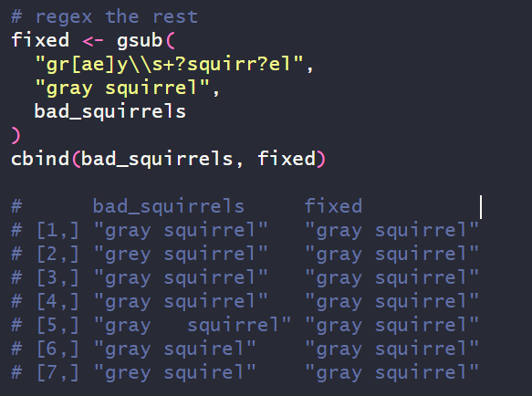
How to fix typos in R

Slide 23
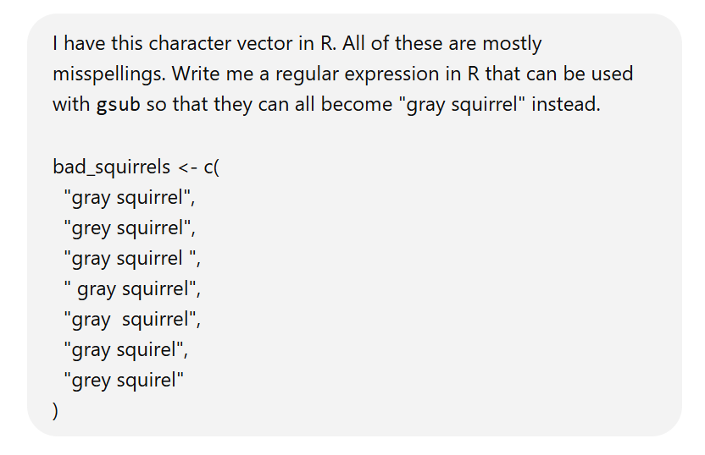
How to figure out regular expressions in R?
Lots of tutorials online (in English), plus the help files associated to the grep() family of functions that are used for pattern matching and replacement.
ChatGPT is GREAT for stuff like this.

Slide 24
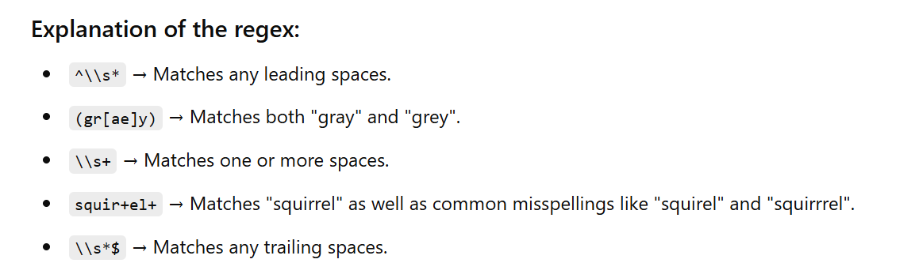

Slide 25
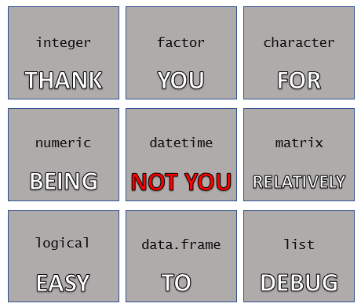
Common pitfalls I’ve encountered
Date/time objects are going to ruin your analysis…
Camera traps malfunction
You forgot to set the date/time
You have data from different time zones
Some times zones use daylight savings time, others do not

Slide 26
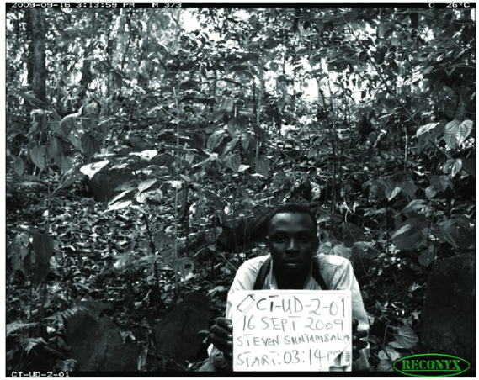
How to fix datetime issues
Always trigger camera when deploying and picking up. Some people will bring a whiteboard with them & trigger with site info, date & time.

Slide 27
How to fix datetime issues
Locate offending images
Find the photo you know the correct date/time
Figure out how many seconds to add/subtract from that image
Add/subtract that many seconds from offending images

Slide 28
Helpful functions and packages in R for dealing with datetime issues
OlsonNames() provides all the time zones available in R. There are almost 600!
The lubridate package is the best package for creating and handling datetime objects. www.lubridate.tidyverse.org
Don’t know the time zone but have the spatial coordinates? The lutz (look up time zone) package can help you with that.

Slide 29
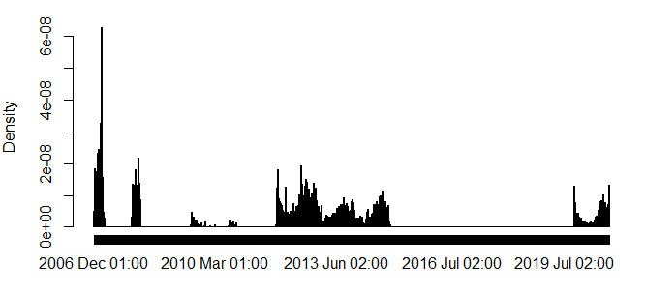
Locating datetime issues
Remember the default datetime for your cameras. If you have a lot of data on January 1st of a given year it may mean that you forgot to set the datetime!
You can make histograms with datetime objects in R
hist(
data$datetime,
breaks = “weeks”
)

Slide 30
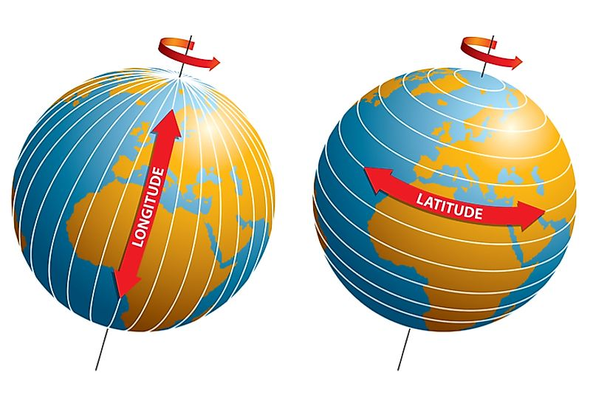
A lot of people can’t remember longitude = x and latitude = y
Spatial coordinates are going to ruin your analysis because someone…
forgot to add a negative to either latitude or longitude
switched latitude & longitude
provided data in another coordinate system instead (e.g., UTMs)
the coordinates are just wrong

Slide 31
Things to check with latitude / longitude data
Latitude ranges from -90 to 90. Anything outside those bounds is an error.
Longitude ranges from -180 to 180. Anything outside of those bounds is an error (there are some exceptions, oceanic / climate models usually go 0 to 360).
Decimal placement errors can move you into weird areas.
Keep at least 5 to 6 decimal points to increase accuracy. A shift of about 1e-5 decimal degrees is about a meter.

Slide 32
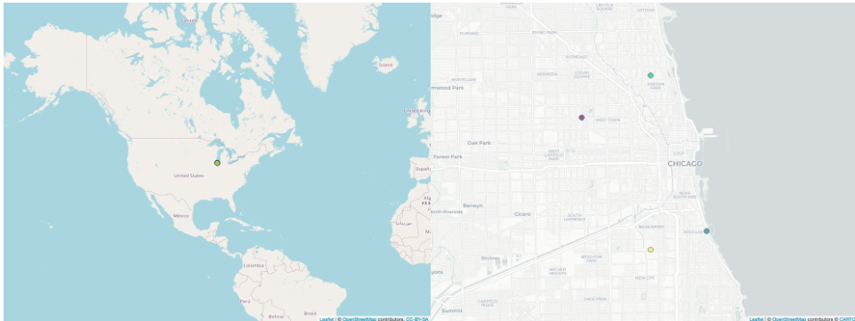
Fixing spatial coordinates means plotting your data is mandatory
Plot them out
(blog post I wrote with how to do this in R)
https://masonfidino.com/investigate_spatial_data/

Slide 33
Great R packages (currently) for spatial data analysis
Package | Uses
sf | Spatial points and vector data.
terra | Raster data, works with sf (mostly)
ggplot2 | Plot data
prettymapr | Add North arrow and scale bar to a map
osmdata | Getting background maps

Slide 34
On occupancy modeling…

Slide 35
Occupancy models are logistic regression models that account for excess zeroes in your response variable…
Know the ins and outs of logistic regression / glms. It will help you with occupancy modeling.
How to interpret regression coefficients
How to convert them back to probabilities
How to make predictions from your model with new data

Slide 36
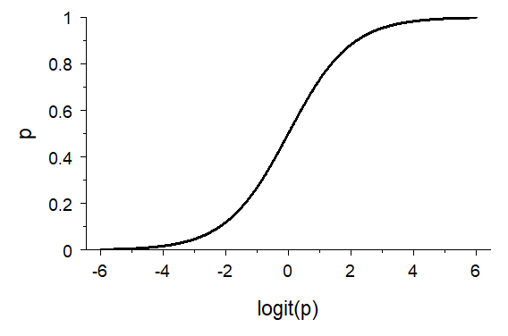
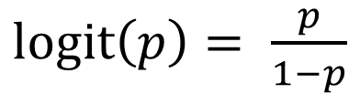
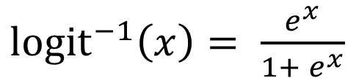
The link functions for logistic regression are non-linear. This is very important to remember.
$logit\left(p\right)= \frac{p}{1−p}$
${logit}^{−1}\left(x\right)= \frac{e^{x}}{1+ e^{x}}$
Across the range of possible values logit(p) can take (-ꝏ, ꝏ) , a small change in logit(p) does not result in a uniform change in p.

Slide 37
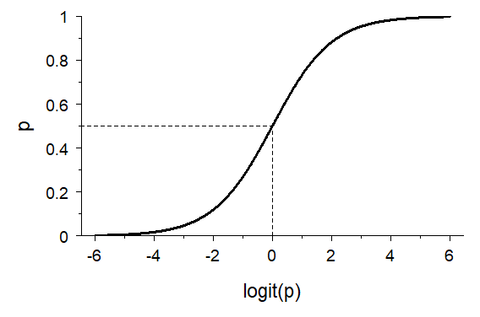
The link functions for logistic regression are non-linear. This is very important to remember.
$logit\left(p\right)= \frac{p}{1−p}$
${logit}^{−1}\left(x\right)= \frac{e^{x}}{1+ e^{x}}$
p = 0.5
Across the range of possible values logit(p) can take (-ꝏ, ꝏ) , a small change in logit(p) does not result in a uniform change in p.
0

Slide 38
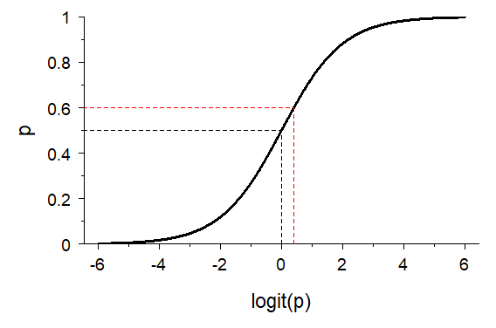
The link functions for logistic regression are non-linear. This is very important to remember.
$logit\left(p\right)= \frac{p}{1−p}$
p = 0.6
${logit}^{−1}\left(x\right)= \frac{e^{x}}{1+ e^{x}}$
p = 0.5
Across the range of possible values logit(p) can take (-ꝏ, ꝏ) , a small change in logit(p) does not result in a uniform change in p.
0
0.4

Slide 39
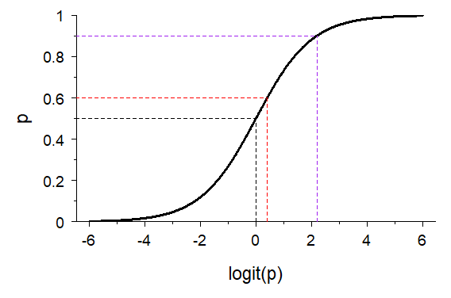
The link functions for logistic regression are non-linear. This is very important to remember.
$logit\left(p\right)= \frac{p}{1−p}$
p = 0.9
p = 0.6
2.2
${logit}^{−1}\left(x\right)= \frac{e^{x}}{1+ e^{x}}$
p = 0.5
Across the range of possible values logit(p) can take (-ꝏ, ꝏ) , a small change in logit(p) does not result in a uniform change in p.
0
0.4

Slide 40
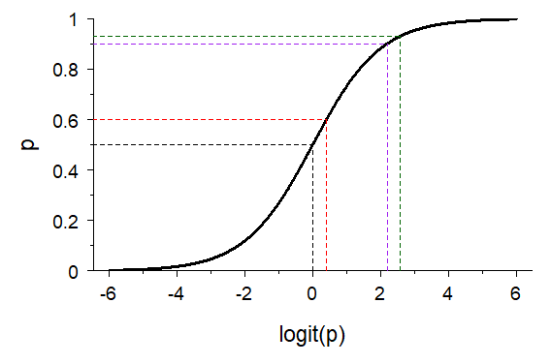
The link functions for logistic regression are non-linear. This is very important to remember.
p = 0.93
$logit\left(p\right)= \frac{p}{1−p}$
p = 0.9
p = 0.6
2.2
2.6
${logit}^{−1}\left(x\right)= \frac{e^{x}}{1+ e^{x}}$
p = 0.5
Across the range of possible values logit(p) can take (-ꝏ, ꝏ) , a small change in logit(p) does not result in a uniform change in p.
0
0.4

Slide 41
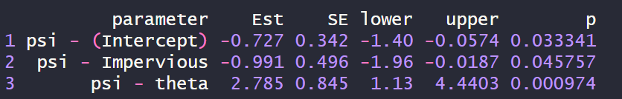
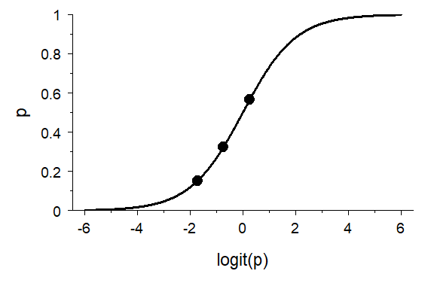
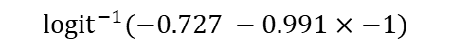

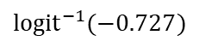
This means that the model intercept in an occupancy model helps inform the magnitude of a one-unit change in logit(p)
$${logit}^{−1}(−0.727 −0.991×−1)$$
One unit decrease in slope
$${logit}^{−1}(−0.727)$$
Intercept only
$${logit}^{−1}(−0.727 −0.991×1)$$
One unit increase in slope

Slide 42
Talking about responses in terms of probability provides much more helpful interpretations.
Writing sample A
Writing sample B
Opossum average occupancy was low (β₀ = -1.40; 95% CI = -1.80, -1.00) and decreased with increasing impervious cover (β₁ = -0.90; 95% CI = -1.30, -0.50).
Average occupancy of opossum was low (0.20; 95% CI = 0.14, 0.27). When the proportion of impervious cover increased from 0.3 to 0.5 opossum occupancy was about two times lower (0.09; 95% CI = 0.05, 0.15).

Slide 43
References
Kays, R., Arbogast, B. S., Baker‐Whatton, M., Beirne, C., Boone, H. M., Bowler, M., ... & Spironello, W. R. (2020). An empirical evaluation of camera trap study design: How many, how long and when?. Methods in Ecology and Evolution, 11(6), 700-713.
Broman, K. W., & Woo, K. H. (2018). Data organization in spreadsheets. The American Statistician, 72(1), 2-10.
Fidino, M., Barnas, G. R., Lehrer, E. W., Murray, M. H., & Magle, S. B. (2020). Effect of lure on detecting mammals with camera traps. Wildlife Society Bulletin, 44(3), 543-552.
Gilbert, N. A., Pease, B. S., Anhalt-Depies, C. M., Clare, J. D., Stenglein, J. L., Townsend, P. A., ... & Zuckerberg, B. (2021). Integrating harvest and camera trap data in species distribution models. Biological Conservation, 258, 109147.
Fidino, M., Lehrer, E. W., Kay, C. A., Yarmey, N. T., Murray, M. H., Fake, K., ... & Magle, S. B. (2022). Integrated species distribution models reveal spatiotemporal patterns of human–wildlife conflict. Ecological Applications, 32(7), e2647.

Slide 44
References
Zuckerberg, B., Cohen, J. M., Nunes, L. A., Bernath-Plaisted, J., Clare, J. D., Gilbert, N. A., ... & Desrochers, A. (2020). A review of overlapping landscapes: pseudoreplication or a red herring in landscape ecology?. Current Landscape Ecology Reports, 5, 140-148.
Moll, R. J., Cepek, J. D., Lorch, P. D., Dennis, P. M., Robison, T., & Montgomery, R. A. (2020). At what spatial scale (s) do mammals respond to urbanization?. Ecography, 43(2), 171-183.

Slide 45
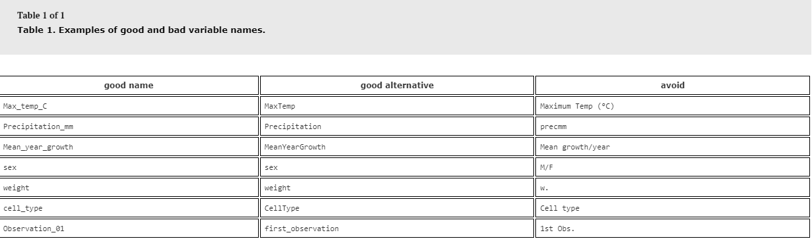
Since we are on the topic of tables…
Most people name columns in a way that is difficult for R to handle.

Slide 46
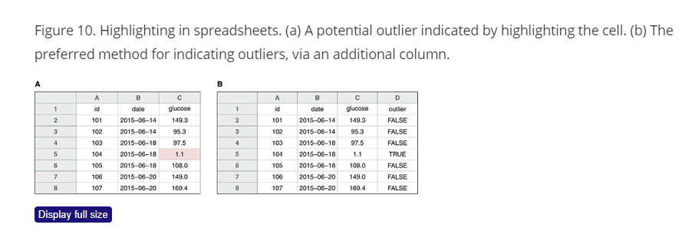
Since we are on the topic of tables…
Stop highlighting data with font colors and the like. R does not read that in.
See Broman and Woo (2018) for more tips

